Slide 1
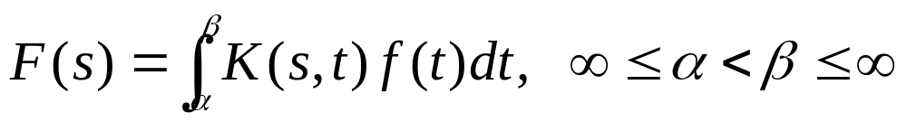
Ch 6.1: Definition of Laplace Transform
Many practical engineering problems involve mechanical or electrical systems acted upon by discontinuous or impulsive forcing terms.
For such problems the methods described in Chapter 3 are difficult to apply.
In this chapter we use the Laplace transform to convert a problem for an unknown function f into a simpler problem for F, solve for F, and then recover f from its transform F.
Given a known function K(s,t), an integral transform of a function f is a relation of the form

Slide 2
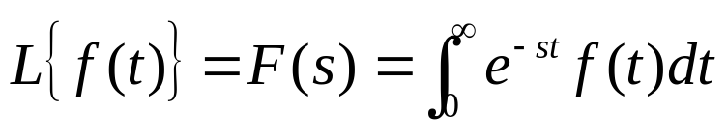
The Laplace Transform
Let f be a function defined for t ≥ 0, and satisfies certain conditions to be named later.
The Laplace Transform of f is defined as
Thus the kernel function is K(s,t) = e^{-st}.
Since solutions of linear differential equations with constant coefficients are based on the exponential function, the Laplace transform is particularly useful for such equations.
Note that the Laplace Transform is defined by an improper integral, and thus must be checked for convergence.
On the next few slides, we review examples of improper integrals and piecewise continuous functions.

Slide 3
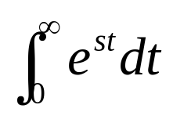
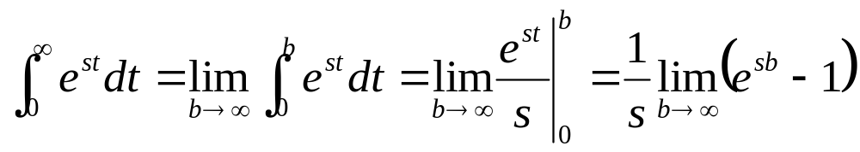
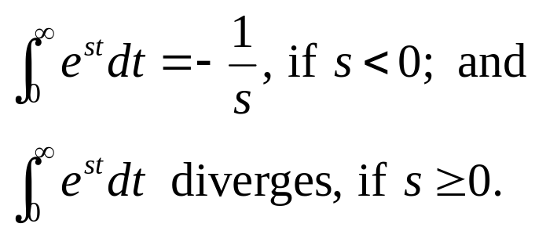
Example 1
Consider the following improper integral.
We can evaluate this integral as follows:
Note that if s = 0, then e^{st} = 1. Thus the following two cases hold:

Slide 4
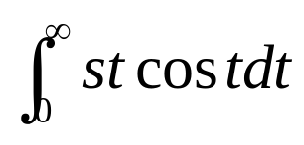
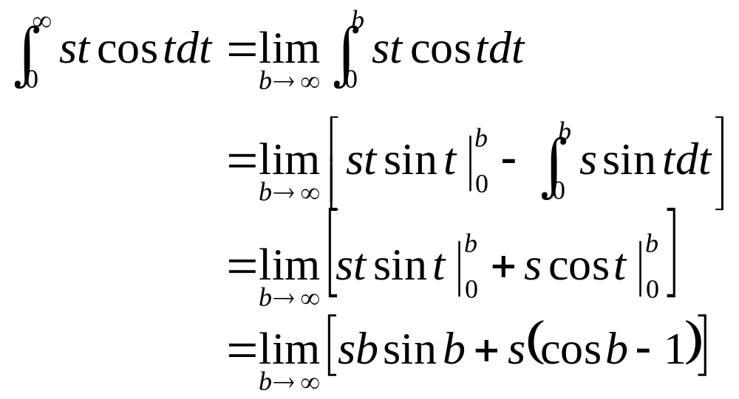
Example 2
Consider the following improper integral.
We can evaluate this integral using integration by parts:
Since this limit diverges, so does the original integral.

Slide 5
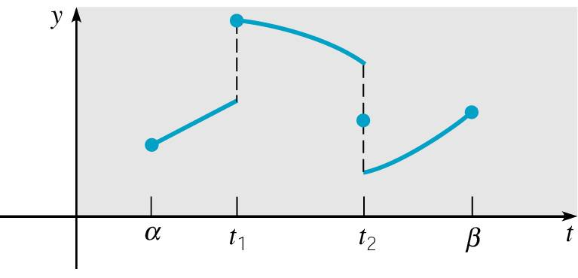
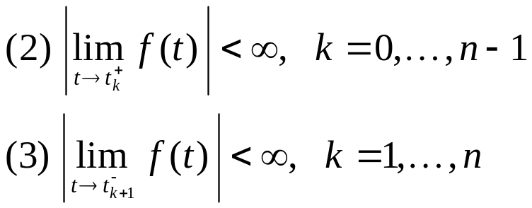
Piecewise Continuous Functions
A function f is piecewise continuous on an interval [a, b] if this interval can be partitioned by a finite number of points
a = t₀ < t₁ < … < t_{n} = b such that
  (1) f is continuous on each (t_{k}, t_{k+1})
In other words, f is piecewise continuous on [a, b] if it is continuous there except for a finite number of jump discontinuities.

Slide 6
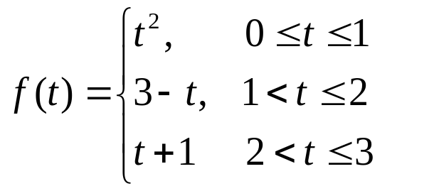
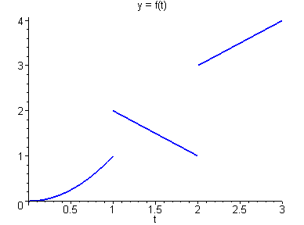
Example 3
Consider the following piecewise-defined function f.
From this definition of f, and from the graph of f below, we see that f is piecewise continuous on [0, 3].

Slide 7
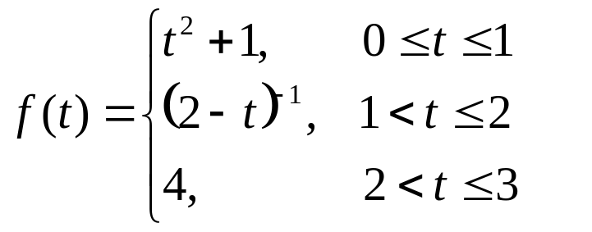
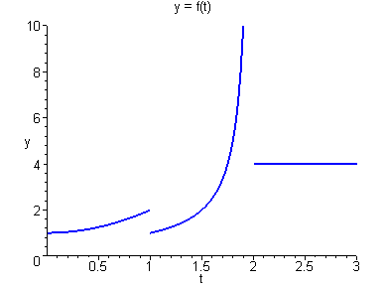
Example 4
Consider the following piecewise-defined function f.
From this definition of f, and from the graph of f below, we see that f is not piecewise continuous on [0, 3].

Slide 8
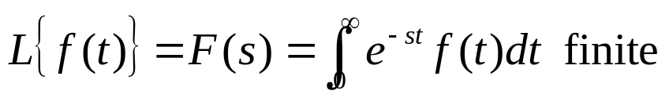
Theorem 6.1.2
Suppose that f is a function for which the following hold:
  (1) f is piecewise continuous on [0, b] for all b > 0.
  (2) | f(t) | ≤ Ke^{at} when t ≥ M, for constants a, K, M, with K, M > 0.
Then the Laplace Transform of f exists for s > a.
Note: A function f that satisfies the conditions specified above is said to to have exponential order as t → ∞.

Slide 9
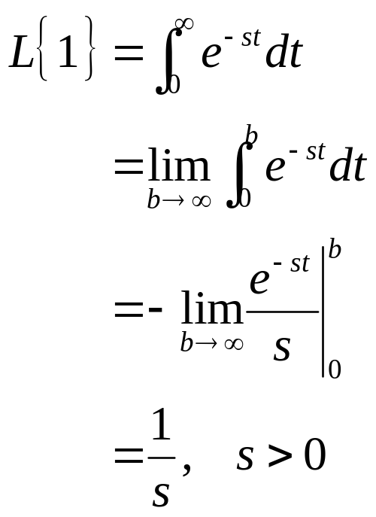
Example 5
Let f (t) = 1 for t ≥ 0. Then the Laplace transform F(s) of f is:

Slide 10
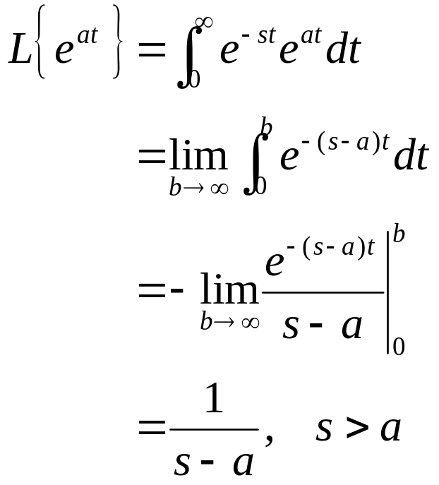
Example 6
Let f (t) = e^{at} for t ≥ 0. Then the Laplace transform F(s) of f is:

Slide 11
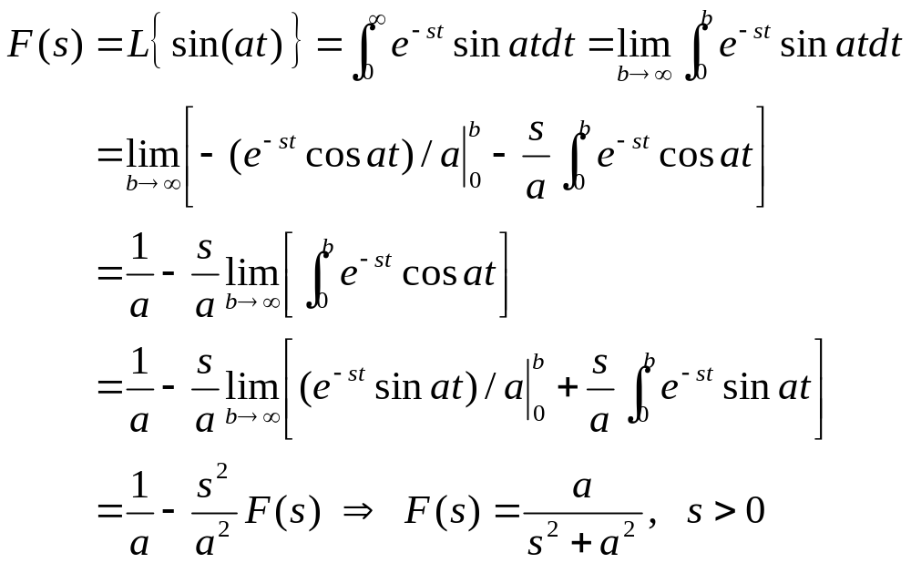
Example 7
Let f (t) = sin(at) for t ≥ 0. Using integration by parts twice, the Laplace transform F(s) of f is found as follows:

Slide 12
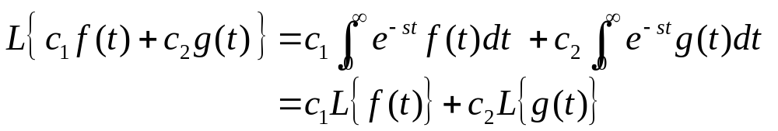
Linearity of the Laplace Transform
Suppose f and g are functions whose Laplace transforms exist for s > a₁ and s > a₂, respectively.
Then, for s greater than the maximum of a₁ and a₂, the Laplace transform of c₁ f (t) + c₂g(t) exists. That is,
with

Slide 13
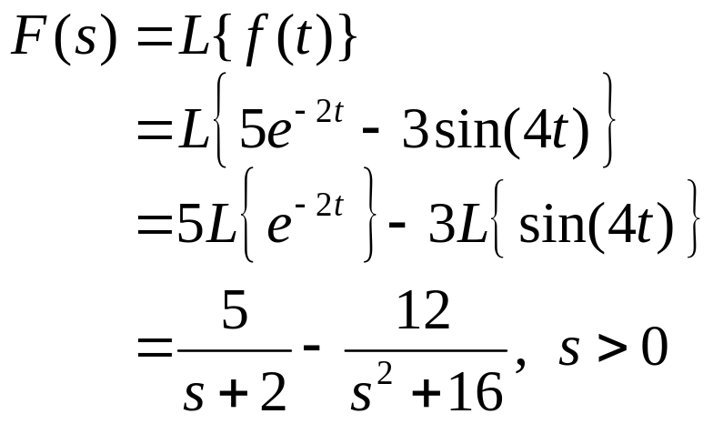
Example 8
Let f (t) = 5e^{-2t} - 3sin(4t) for t ≥ 0.
Then by linearity of the Laplace transform, and using results of previous examples, the Laplace transform F(s) of f is:

